Slide 1
Database Project
Train Ticketing System
Abdullah (049)
Aroob (029)
Saiqa (081)

Slide 2
Table of contents
01
Problem Statment
03
Reqirement Resources
ERD
02
User Interface WireFrames
04
Why and what database is designed.
Entity Relationship Diagram

Slide 3
Table of contents
05
Relational Mapping
06
Normalization Process
07
Final Set of Relations
08
Conclusion
ERD to relational mapping

Slide 4
01
Problem Statement
Why and what database is designed.

Slide 5
Problem Statement
With the ever increasing population and the not so fast growing infrastructure, the railway reservation system needs a supporting portal to manage the physical rush. This calls for a railway reservation/ticketing system for manipulation of data.

Slide 6
02
User Interface Wireframes

Slide 7
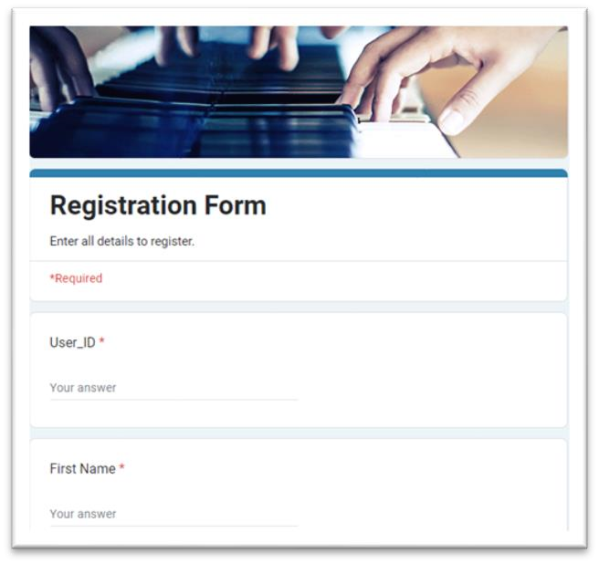
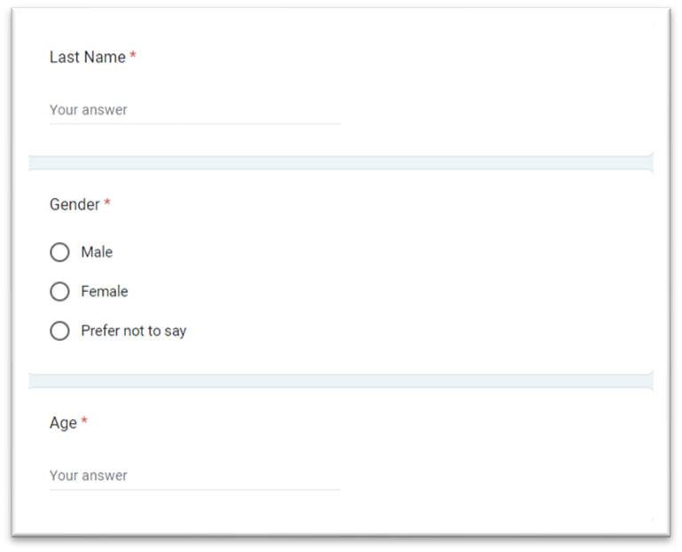
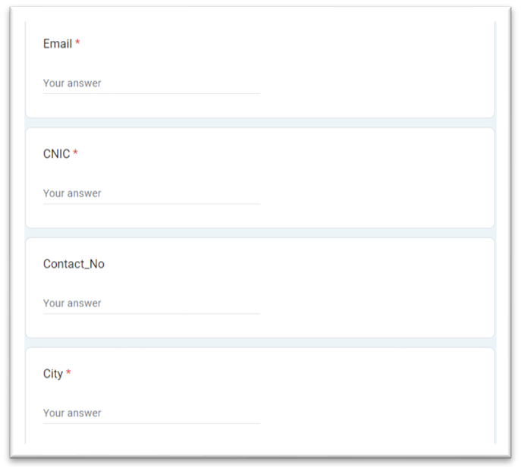
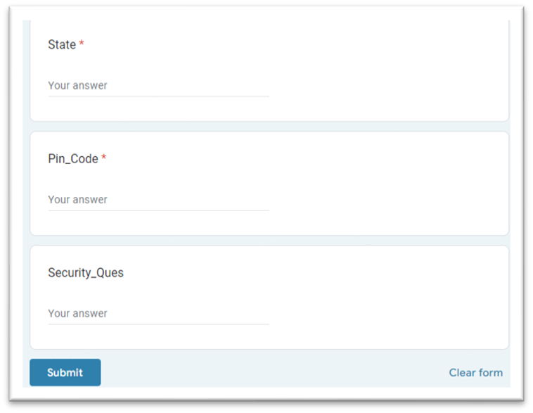

Slide 8
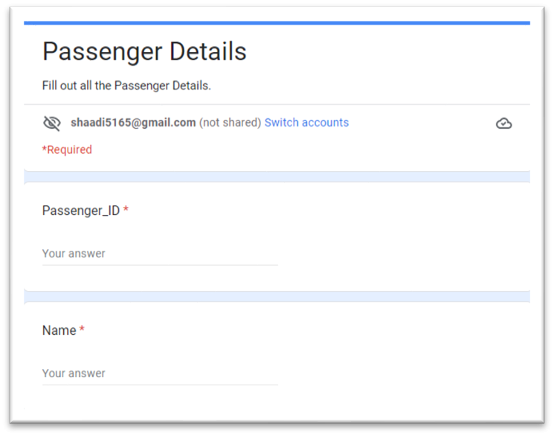
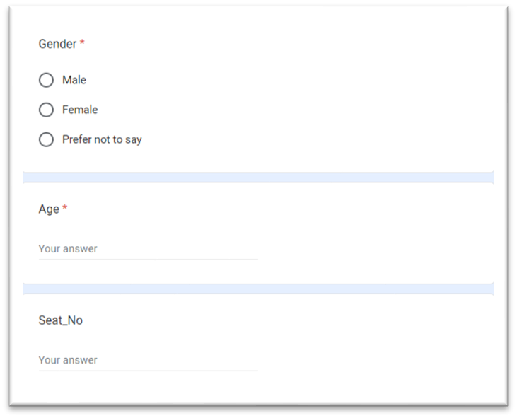
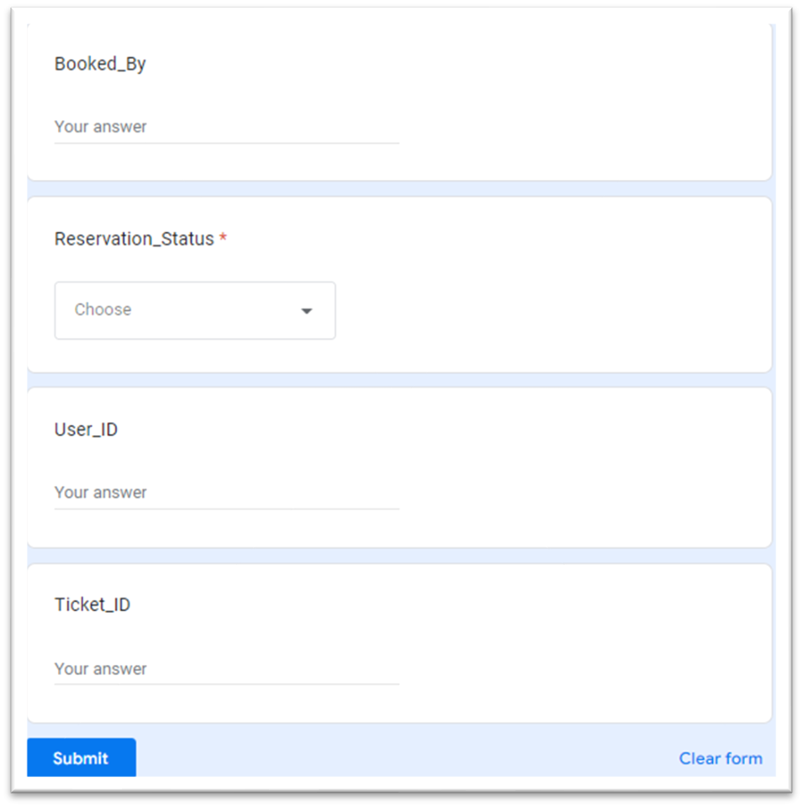

Slide 9
03
Requirement Resources

Slide 10
Requirement Resources
We took help from a PDF from SciVerse Science Direct
https://www.sciencedirect.com/
We took help from a PDF report of KL University

Slide 11
04
Entity-Relationship Diagram

Slide 12
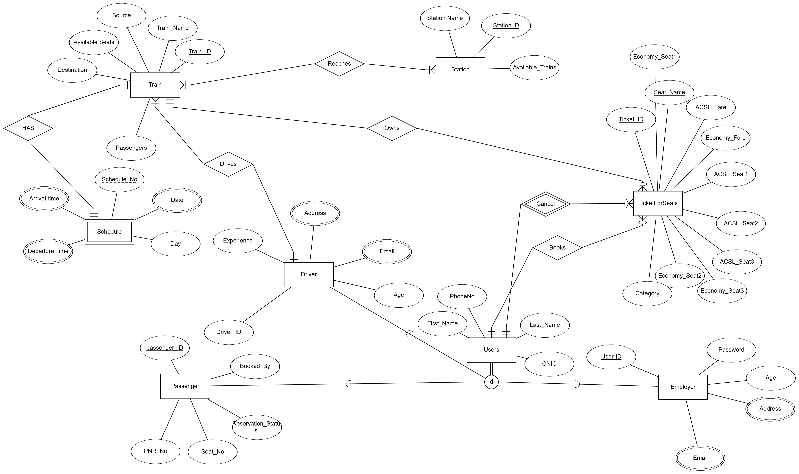

Slide 13
05
Relational Mapping
ERD to relational mapping

Slide 14
Relational Mapping
Train (Train_ID (PK), Train_Name, Available_seats, Passengers, Driver_ID (FK), Destination, Source)
TicketForSeats (Ticket_ID (PK), Economy_seat2, Category, ACSL_Fare, Economy_seat1, Economy_Fare, ACSL_Seat1, ACSL_Seat3, ACSL_Seat2, Economy_Seat3, Seat_Name (U), Train_ID (FK))
Employer (Employer_ID (PK),Password (U), Age)
Passenger (Passenger_ID (PK), PNR_No, Seat_No, Booked_By, Reservation_Status)
Driver (Driver_ID (PK), Experience, Age)
Station (Station_ID (PK), Station_Name, Available_Trains)
Users (Ticket_ID (FK), First_Name, Last_Name, CNIC, Phone_No)

Slide 15
Relational Mapping cont.
Schedule (Schedule_No (PK), Day, Train_ID(FK))
Reaches (Train_ID (FK), Station_ID (FK))
Employer_Address (Address)
Employer_Email (Email (FK))
Schedule_Arrival_Time (Arrival_Time, Schedule_No (FK))
Schedule_Departure_Time (Departure_Time, Schedule_No (FK))
Schedule_Date (Date, Schedule_No (FK))
Driver_Email (Email (FK))
Driver_Address (Address) (FK)

Slide 16
06
Normalization Process

Slide 17
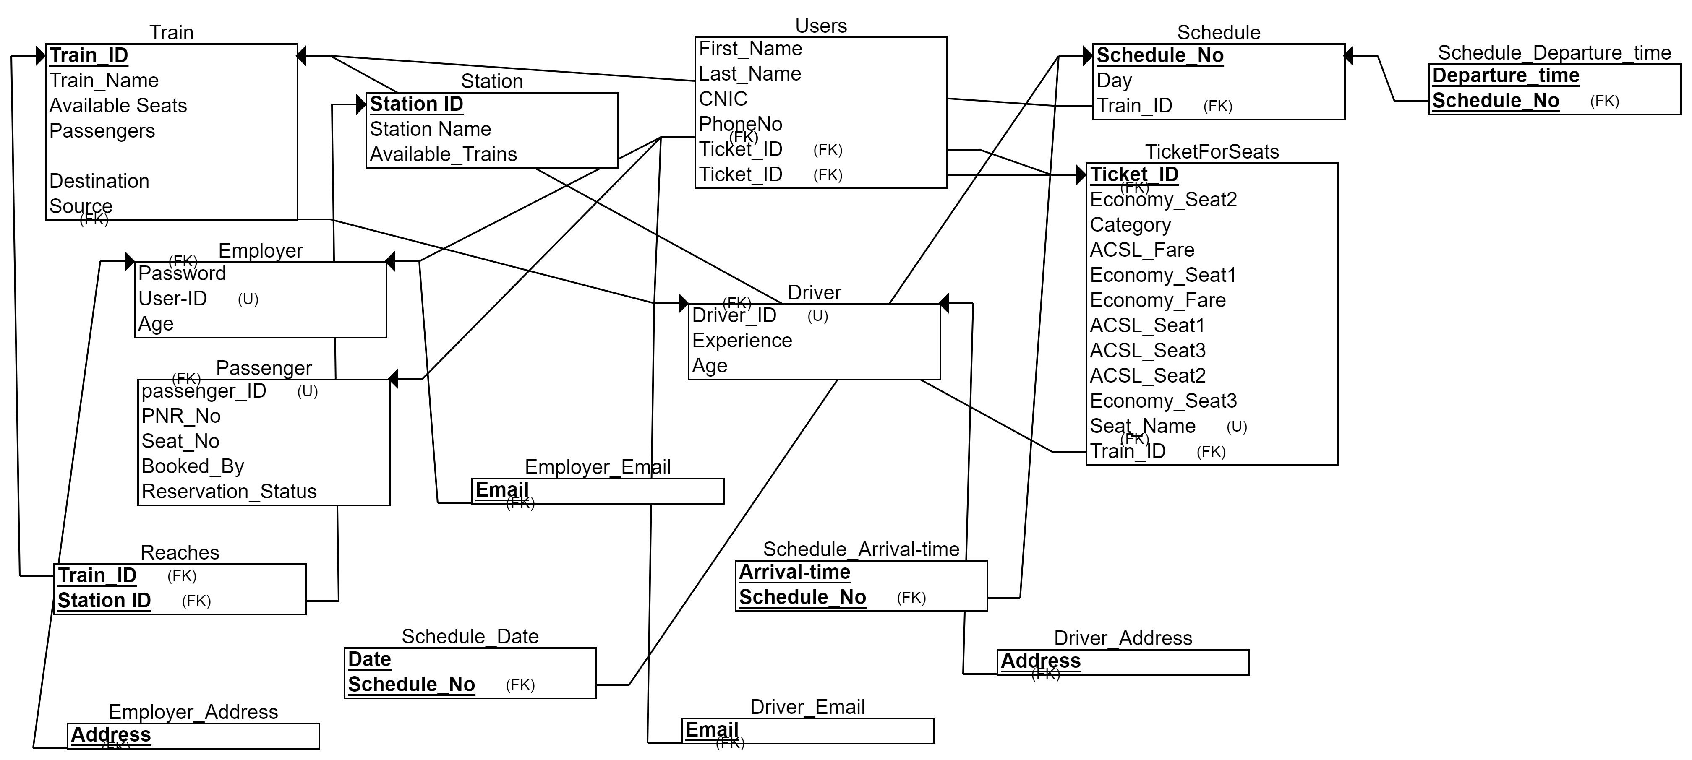
Normalization (2NF)

Slide 18
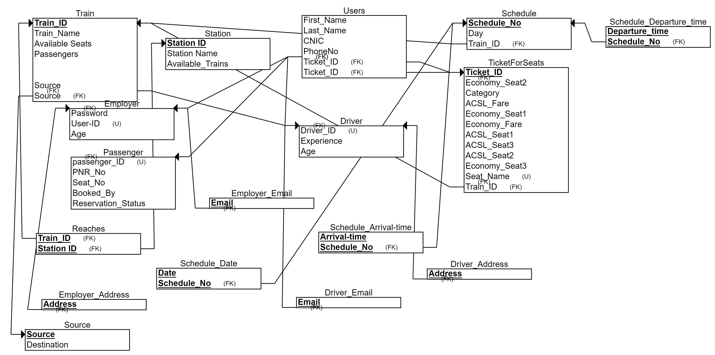
Normalization (3NF)

Slide 19
07
Final Set of Relations

Slide 20
Set of Relations
1. Train has a binary relation of “Reaches” with station. This is a many to many relation such that “A train reaches many stations and A station is reached by many trains” and both are mandatory in this case.
2. Train has a binary relation of “HAS” with schedule too. This is a one to one relation such that “A train has only one schedule and one schedule is assigned to one train only” and both are mandatory.
3. Driver has a binary relation of “Drives” with Train. This is a one to many relation such that “A driver can drive many trains but one train is driven by one driver only” and both are mandatory.

Slide 21
Set of Relations cont.
4. User has a binary relation of “Books” with TicketForSeats. This is a one to many relation such that “A user can book many tickets but each ticket is booked by one user only” and here user is mandatory but TicketForSeats is optional.
5. User has a binary relation of “Cancel” with TicketForSeats too. This is a one to many weak relation such that “A user can cancel many tickets but each ticket is cancelled by one user only” and here User is mandatory but TicketForSeats is optional.

Slide 22
Set of Relations cont.
6. Train has a binary relation of “Owns” with TicketForSeats. This is a one to many relation such that “A train owns many tickets but each ticket is owned by/belomgs to one train only” and here Train is mandatory but TicketForSeats is optional.

Slide 23
08
Conclusion

Slide 24
Conclusion
In our project Train Ticketing System, we will have to store all the information about the Trains scheduled and the users’ booking tickets and even status of trains, seats etc. This data base will be helpful for the applications which facilitate passengers to book the train tickets and check the details of trains and their status from their place itself and avoid inconveniences of going to railway station for each and every query they get. We had considered the most important requirements only, many more features and details can be added to the project in order to obtain even more user-friendly applications. These applications are already in progress and in future they can be upgraded and may become part of amazing technology.

Slide 25

Thank You!

